Slide 1
HOSPITAL MANAGEMENT SYSTEM
Presented by –
Mayur Shirke (21273)
Siddharth Munneshwar (21274)
Sumit Sunke (21275)
Pavan Thorat (21277)
Mayur Valvi (21280)

Slide 2
Contents
Problem statement
Software requirement
System design
System implementation
Advantages and future scope

Slide 3
Problem Statement
To develop an improved hospital appointment booking system that improves the patient experience, efficient scheduling process, minimizes waiting times and increases operational efficiency.

Slide 4
Software Requirements
Technologies used – HTML , CSS , JS , ReactJS , NodeJS , MongoDB , Framework – Bootstrap 5 , Editor – VSCode.
Hardware requirements –
Processor – intel i3/i5/i7 or AMD Ryzen 3/5/7 .
RAM – at least 4GB.
Storage – 256GB(HDD/SSD) or more.

Slide 5
System Implementation
User login
Select appointment date
System checks availability
If available, system saves appointment
if not available , user choose another date or cancels.
System sends confirmation to user.
Flow diagram

Slide 6
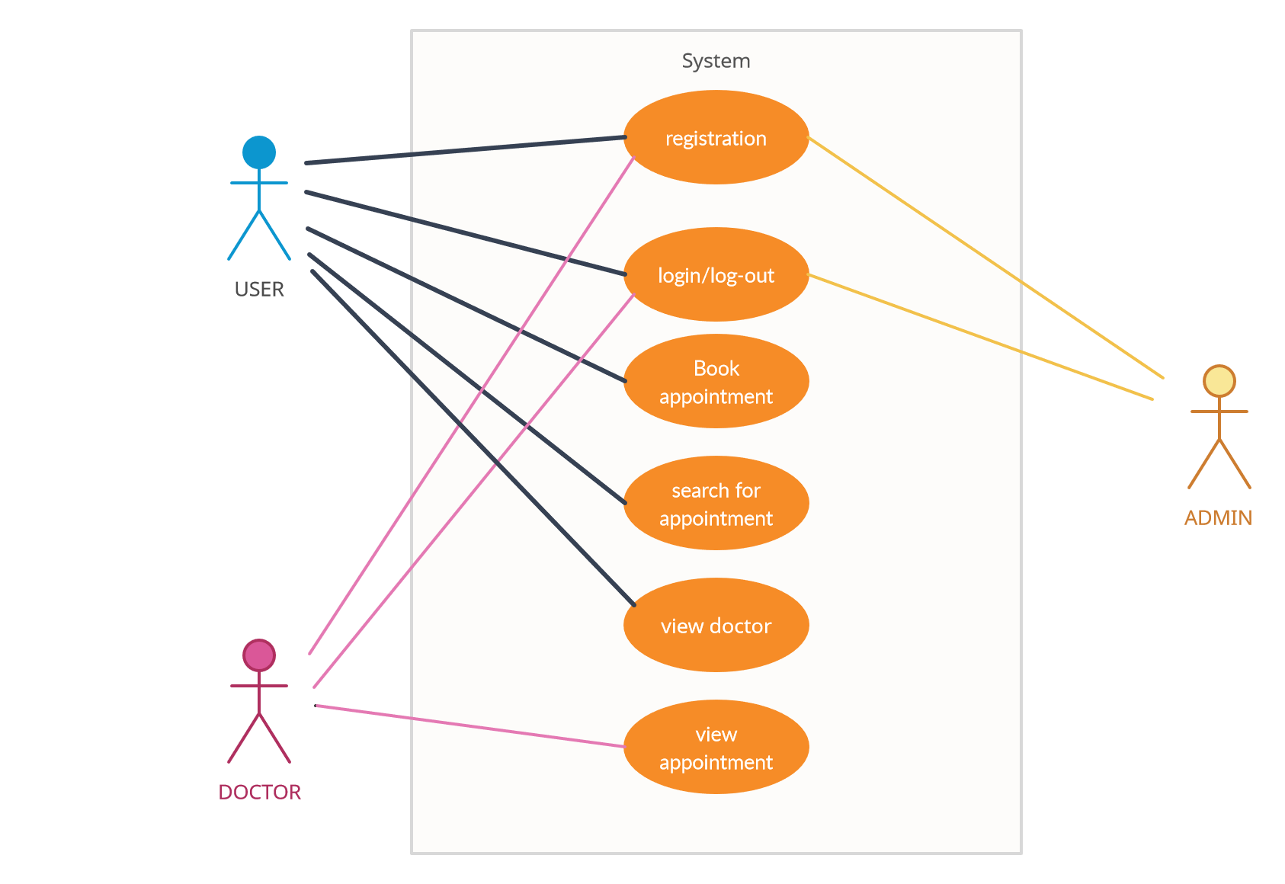
System Implementation
Use Case Diagram

Slide 7
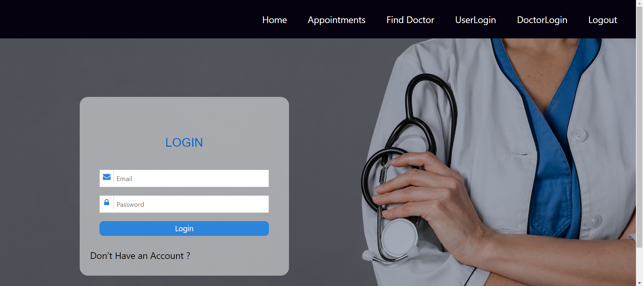
System Implementation
Login and registration of user.

Slide 8
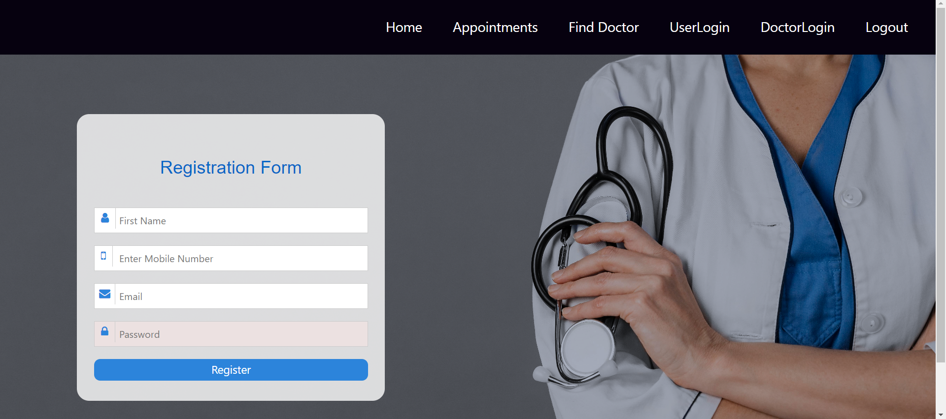
System Implementation

Slide 9
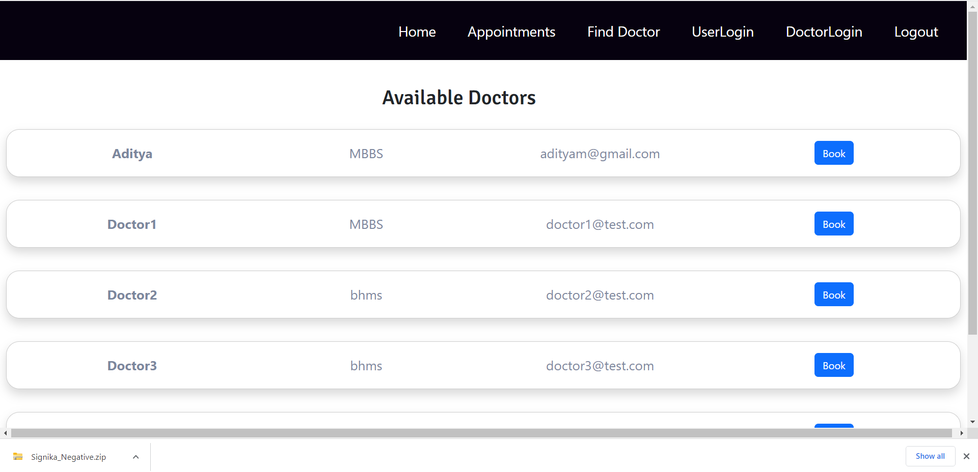
System Implementation
Appointments –

Slide 10
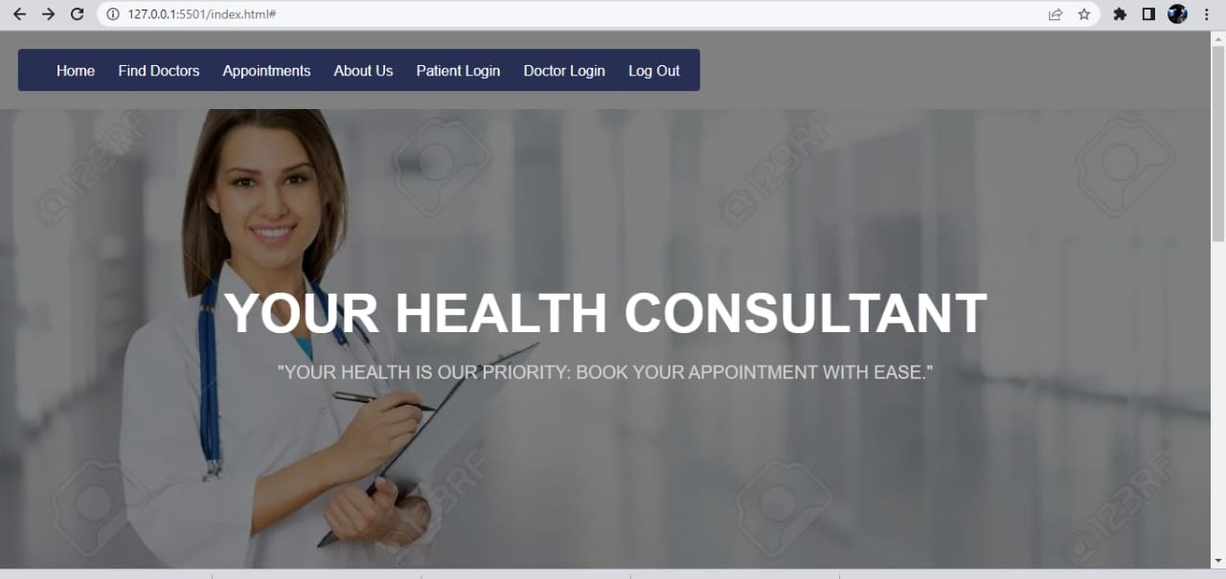
System Implementation
Other pages

Slide 11
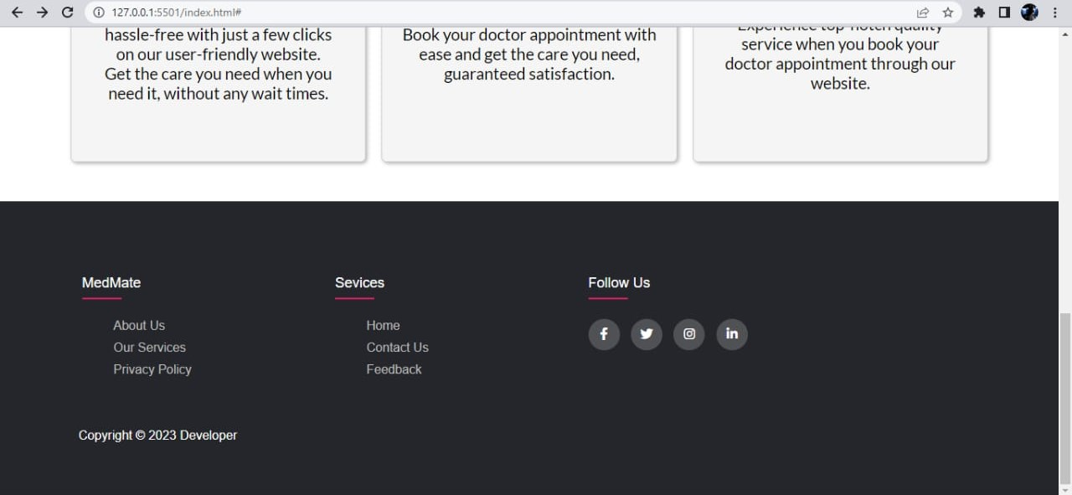

Slide 12
Advantages and future scope.
Advantages -
Convenience: System provides convenience to both users and healthcare providers. Users can easily book appointments at their preferred time and from anywhere with internet access.
24/7 Accessibility: With an online appointment booking system, users have the flexibility to book appointments at any time, including outside of regular business hours.
Improved Data Accuracy: Manual appointment booking processes are prone to errors and inconsistencies. An appointment booking system helps minimize errors by capturing accurate user information, appointment details, and ensuring proper data validation.
Enhanced User Experience: Users appreciate the convenience, speed, and flexibility provided by the system, resulting in higher user satisfaction and increased loyalty to the healthcare facility.

Slide 13
Advantages and future scope
Future scope –
Artificial Intelligence and Machine Learning: Implementing AI and machine learning algorithms can enhance appointment scheduling by analyzing historical data, predicting appointment demand, optimizing resource allocation, and providing personalized recommendations.
Smart Queue Management: Utilizing smart queue management technologies can improve the flow and efficiency of appointments. Users can receive updates about their turn, estimated waiting times, and any delays, reducing frustration and optimizing resource utilization.
Mobile Applications: Developing dedicated mobile applications for appointment booking systems will further enhance user accessibility and convenience.
Patient Feedback and Reviews: Enhancing the appointment booking system with features that allow patients to provide feedback and reviews on their appointment experiences can help improve service quality, increase patient satisfaction.

Slide 14
Conclusion -
By implementing this web based application, the management of the patients will be very much easier, efficient and less time consuming. The patient details are already present in the database while registration so there is no need to fill a form again an. Communications among the doctor and patient are enhanced as the patient can get as much help online. It will help to reduce many manual efforts, time taken and cost.

